Slide 1
Jermyn Borough Council Meeting
12/18/2025

Slide 2

Meeting Agenda
DECEMBER 18, 2025
CALL TO ORDER
PLEDGE OF ALLEGIANCE
ROLL CALL
PREVIOUS MEETING MINUTES
TREASURE REPORT/BILLS PAYABLE
CORRESPONDENCE
SECRETARY REPORT
PUBLIC COMMENT
PROFESSIONAL REPORTS
COMMITTEE REPORTS
GARBAGE BID OPENING
NORLACK MOTIONS
2026 BUDGET
2026 TAX RESOLUTION
2026 MEETING DATES
R AND L FOLLOW UP
NEW BUSINESS
ADJOURNMENT

Slide 3
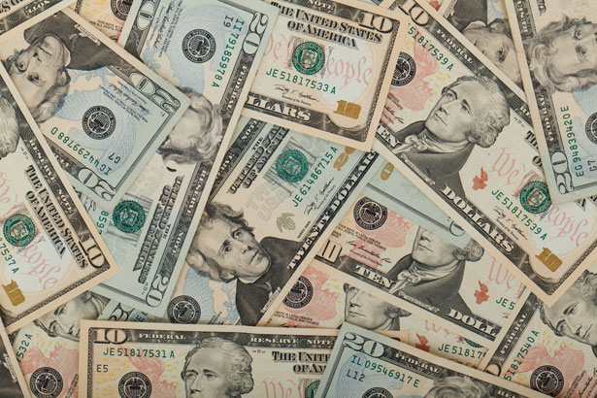
Treasurer’s report
12/18/2025
ASSETS
Checking/Savings
American Rescue Plan Fund 92,603.37
Capital Reserve - DPW 1,207.95
Capital Reserve - Police 7,074.82
Crime Watch Fund 222.69
General Fund - Community 97,852.51
General Fund - FNB 4,698.58
Holiday Lights Fund 400.59

Slide 4
Treasurer’s report
Investment - General Fund 1,170.02
Investment - Liquid Fuels 25,759.63
Investment - Paving Fund 1,182.13
Investment - Recycling 129.04
Investment - Refuse 184.22
Liquid Fuels - FNB 22,683.87
Petty Cash 194.00
Recreations Fund 20,833.99
Recycling - Community 9,369.64
Refuse Checking - FNB 130,375.19
Total Checking/Savings 415,942.24

Slide 5
Treasurer’s report
200000 · Accounts Payable 11,328.20
Long Term Debt 0

Slide 6


